Slide 1
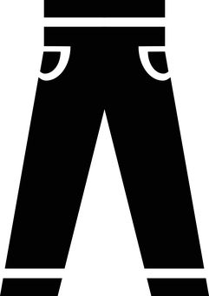
Modified Trousers
INITIAL CONDITION
SOLUTION
If a machine needs any adjustment, the maintainer usually takes his heavy toolbox (an ergonomic issue). He may forget some tools if he hold them by hand causing waste of time resulting in machine downtime.
BEFORE PHOTO
We have provided all maintainers with trousers that have two pockets (one at each side) to hold their most important and used tools.
AFTER PHOTO
KEY BENEFITS
Each maintainer now can keep his tools with him all the time.
REPLICATION OPPORTUNITIES
Setup, changeover, and quick-repair teams.
No need to search toolboxes, no ergonomic issues, and less machine downtime.
Technicians in utilities, facilities, and workshop departments.
DEPARTMENT / DIVISION
BUSINESS DIMENSION
PROCESS / SCOPE
PERFORMANCE ATTRIBUTE
APPROACH
Production
Maintenance and Reliability
Maintenance in all production lines
Efficiency
Quick Win
ORIGINATED BY
VALIDATED BY
APPROVED BY
CONTACT DETAILS
Notes:
Best Practice Template – © Copyright Continuous Improvement Toolkit . www.citoolkit.com

