Slide 1
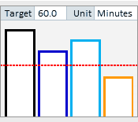
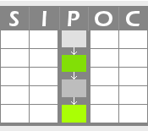
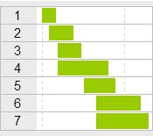
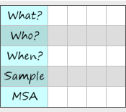
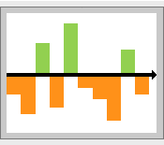
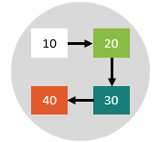
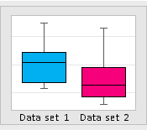
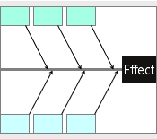
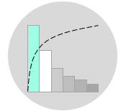
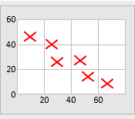
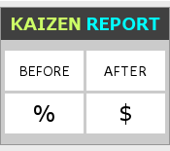
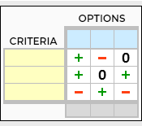
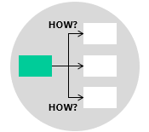
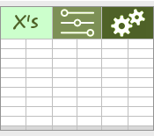
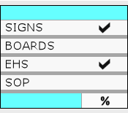
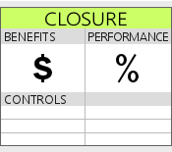
DMAIC Process Guide
D
M
A
I
C
Notes:
© Copyright Citoolkit.com – The Continuous Improvement Toolkit
- These slides are for personal and business use only.
- They can be customized and modified to fit your requirements. We are not liable, however, for any misuse.
- Redistribution, reselling, lease, license, sub-license or offering these slides to a third party are not allowed.
- This also includes uploading them to another website and offering them without reference or maintaining CIToolkit information.
- Some images are taken from pixabay.com, which are commercial free.
- More information can be found at: https://citoolkit.com/terms-and-conditions/
- For any help, more information, or if the file has not been downloaded correctly, please email us at: info@citoolkit.com.

Slide 2
1
Define problem and goal statements
2
Define customer needs
3
Identify high level process map
4
Develop project charter
5
Develop project plan
5
Evaluate measurement system, stability & capability
4
Collect data on the problem and factors
3
Establish a data system
2
Identify key process input variables
1
Create AS-IS process map
1
Review the results of graphical & basic analysis
2
Identify all potential root causes
3
Narrow down potential root causes
4
Verify root causes using statistic
5
Create a prediction model
5
Confirm improvement against baseline
4
Pilot and implement the plan
3
Develop Implementation plan
2
Evaluate, select and optimize best solutions
1
Generate solutions to eliminate root causes & NVAs
1
Prepare a control plan and select control methods
2
Standardize the solutions by updating the SOPs
3
Transfer ownership to process owner
4
Capture and share realized benefits
5
Prepare an audit process and set-up a control dashboard

Slide 3
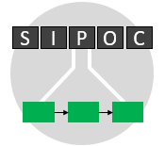
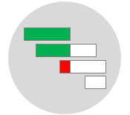
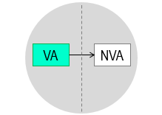
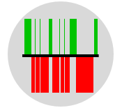
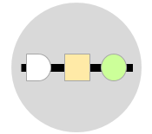
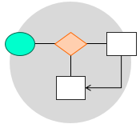
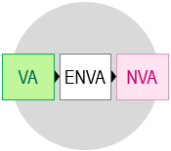
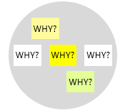
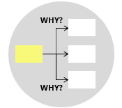
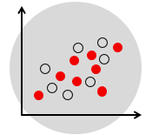
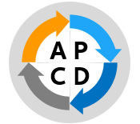
VOC
CTQ
Y=f(x) Cascade
COPQ
PERT
Quick Wins
Force Field Analysis
Pareto Analysis
Prioritization
Kano Analysis
KPIs
SIPOC analysis
VSM
Stakeholder Analysis
Project Charter
Gantt Chart
Risk Analysis
Process Mapping
Capability
Study
SPC
MSA
Measles Chart
Data
Collection
Plan
Operational Definition
Spaghetti
Diagram
Sampling
Normality Study
Interview
Questionnaire
Check Sheet
Observation
Process Chart
Opportunity Flowchart
Time Value Map
Sequence Chart
VSM
Flowchart
Histogram
Box Plot
Run
Chart
Brainstor-ming
5W1H
C&E
Matrix
FMEA
Hypothesis
Testing
ANOVA
Correlation
Regression
Probability Distribution
Waste Analysis
Value Analysis
5 Whys
Why-Why Diagram
Fishbone Diagram
Pareto Analysis
Interrelationship Map
Scatter Diagram
DOE
Capability
Study
SPC
MSA
Quick Wins
Kaizen Events
Pilot Study
Brainstor-ming
SCAMPER
Normality Study
Graphical Methods
Flowchart
PDCA
Risk Analysis
RACI Matrix
Gantt Chart
Paired Comparison
Pugh Matrix
Balanced Sheet
Prioritization Matrix
How-How Diagram
Control Plan
Mistake Proofing
TPM
Training Plan Deployment
Skills Matrix
Lessons Learned
SPC
Process
Audit
Storyboard
Standard Work
SOP
5S
Visual Management
Best Practice Sharing
KPIs
Project Closure

Slide 4
VOC
Kano Analysis
CTQ
Y=f(x) Cascade
COPQ
PERT
Risk Analysis
Quick Wins
Benchmarking
Force Field Analysis
Pareto Analysis
Prioritization
QFD
KPIs
SIPOC analysis
VSM
Stakeholder Analysis
Project Charter
Gantt Chart
Process Mapping
Capability
Study
Normality Study
SPC
MSA
Measles Chart
Interview
Check Sheet
Operational Definition
Opportunity Flowchart
Spaghetti
Diagram
Process Sequence
Chart
Sampling
Questionnaire
Observation
Data Collection Plan
Process Chart
Time Value Map
VSM
Flowchart
Histogram
Box Plot
Probability Distribution
Run
Chart
Waste Analysis
Value Analysis
Brainstor-ming
Why-Why Diagram
5W1H
Relationship Mapping
Hypothesis
Testing
ANOVA
Correlation
Regression
5 Whys
Fishbone Diagram
C&E Matrix
Pareto Analysis
FMEA
Scatter Diagram
DOE
Capability
Study
Normality Study
SPC
MSA
Graphical Methods
Pilot Study
Risk Analysis
Paired Comparison
Decision Balanced Sheet
How-How Diagram
SCAMPER
Brainstor-ming
Flowchart
Kaizen Report
Kaizen Event Charter
PDCA
RACI Matrix
Gantt Chart
Pugh Matrix
Prioritization Matrix
Mistake Proofing
Standard Work
TPM
Training Plan Deployment
Lessons Learned
Best Practice Sharing
SPC
Storyboard
Control Plan
SOP
5S
Visual Management
Skills Matrix
Audit Checklist
KPIs
Project Closure

Slide 5
Made with by
CITOOLKIT
The Continuous Improvement Toolkit www.citoolkit.com
© Copyright Citoolkit.com. All Rights Reserved.

